Slide 1
PHY127 FS 2024
Videos
Prof. Ben Kilminster
Lecture 10
May 10th, 2024

Slide 2
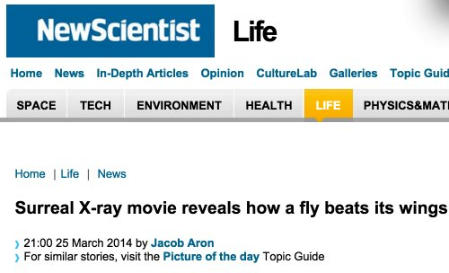
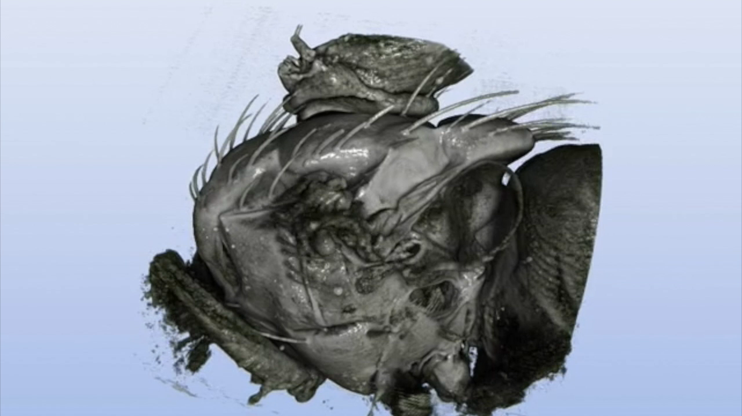
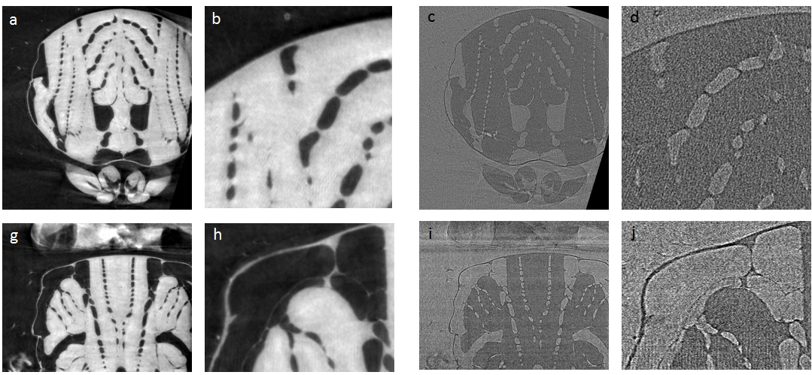
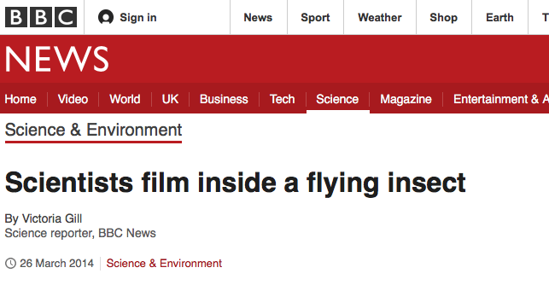
Muscles and tracheal network during flight
Von Prof. Marco Stampanoni / ETHZ und PSI
Walker et al., PloS Biology (2014) & Mokso et al., SciRep (2015)
03.12.19
PGZ slides extrait

