Slide 1
PHY127 FS 2024
Videos
Prof. Ben Kilminster
Lecture 10
May 10th, 2024

Slide 2
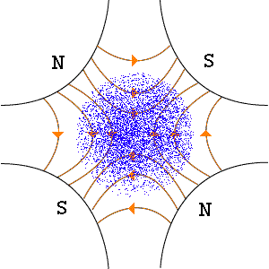
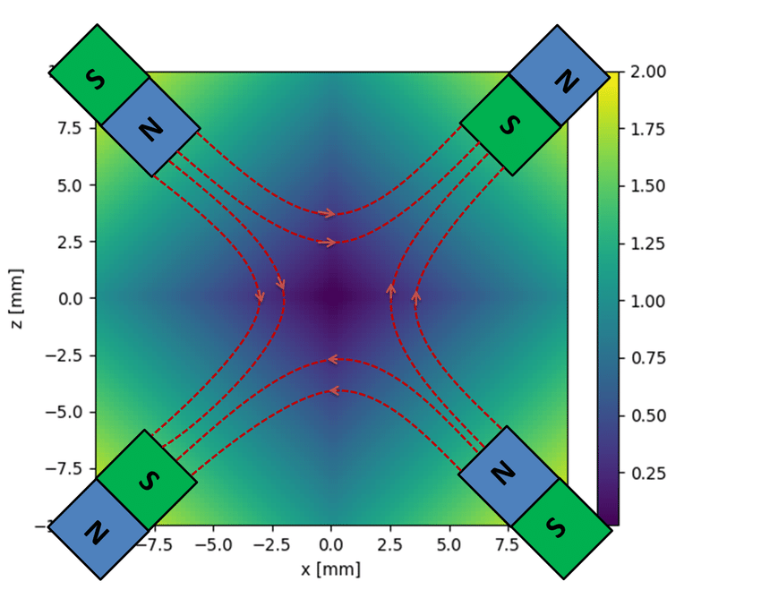

Slide 3
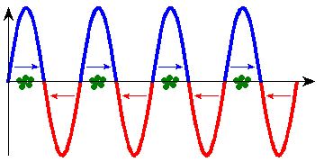
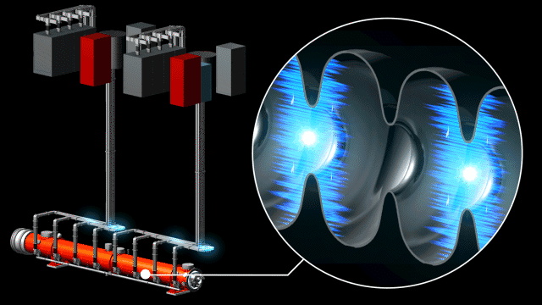
RF acceleration (YouTube video here https://www.youtube.com/watch?v=mu4m7wSnpD0 )
Superconducting RF cavities
May 2022 News : LCLS-II at Stanford will produce X-ray pulses that are 10,000 times brighter, on average, than those of LCLS and that arrive up to a million times per second – a world record for today’s most powerful X-ray light sources.

Slide 4
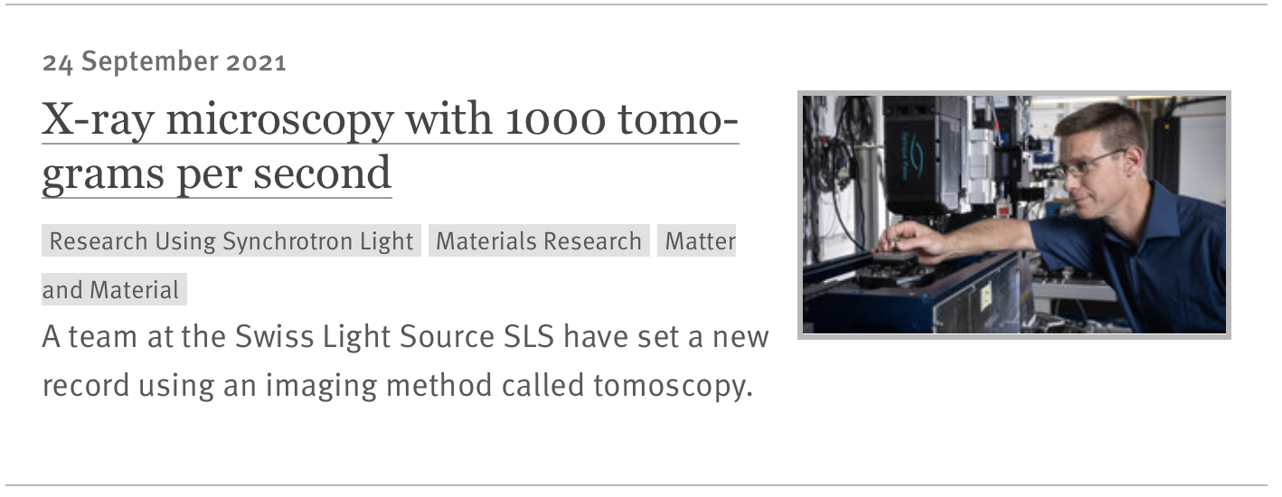
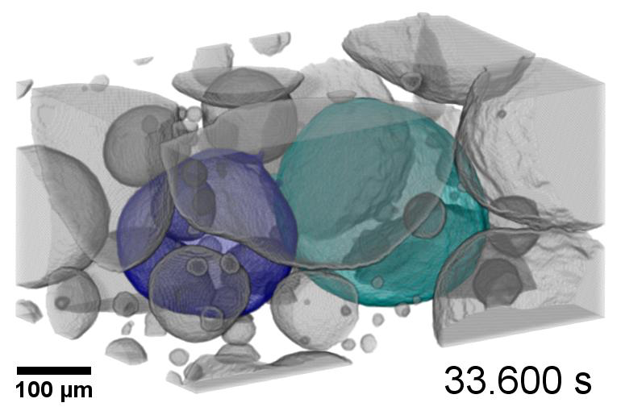
100 μm Bubble coalescence
https://onlinelibrary.wiley.com/doi/10.1002/adma.202104659

Slide 5
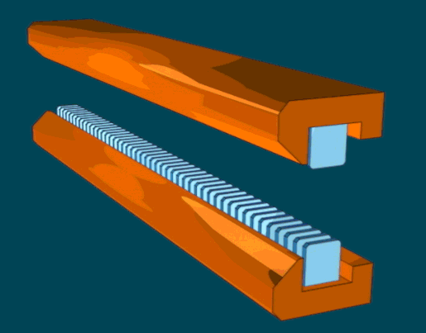
Undulator

Slide 6
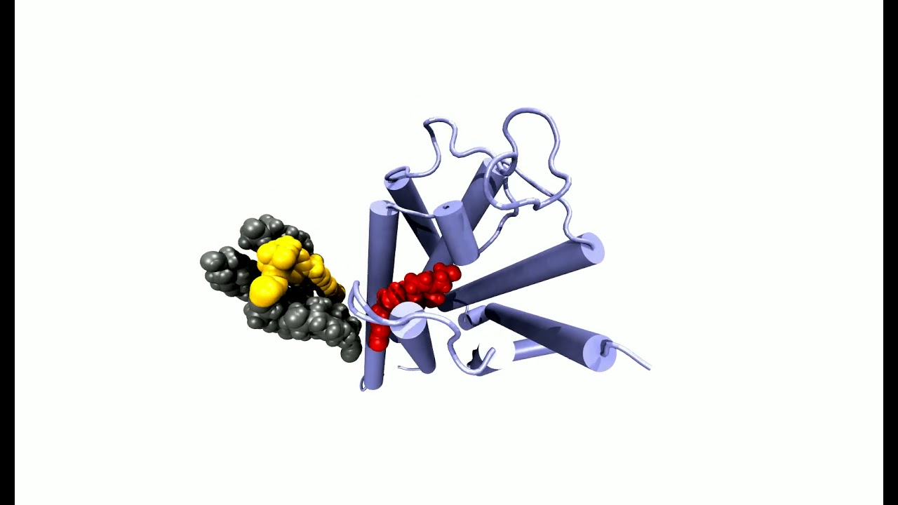
X-ray free-electron laser SwissFEL
Watching receptor proteins change shape

