Slide 1
PHY127 FS 2024
Videos
Prof. Ben Kilminster
Lecture 10
May 10th, 2024

Slide 2
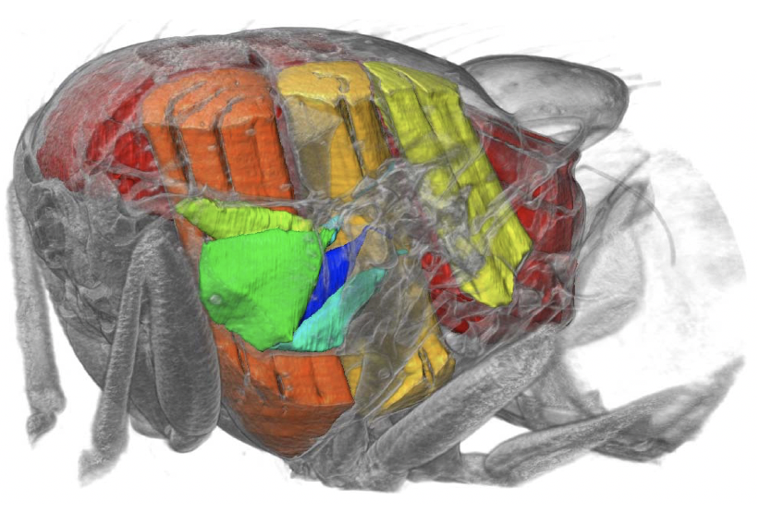
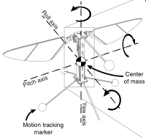
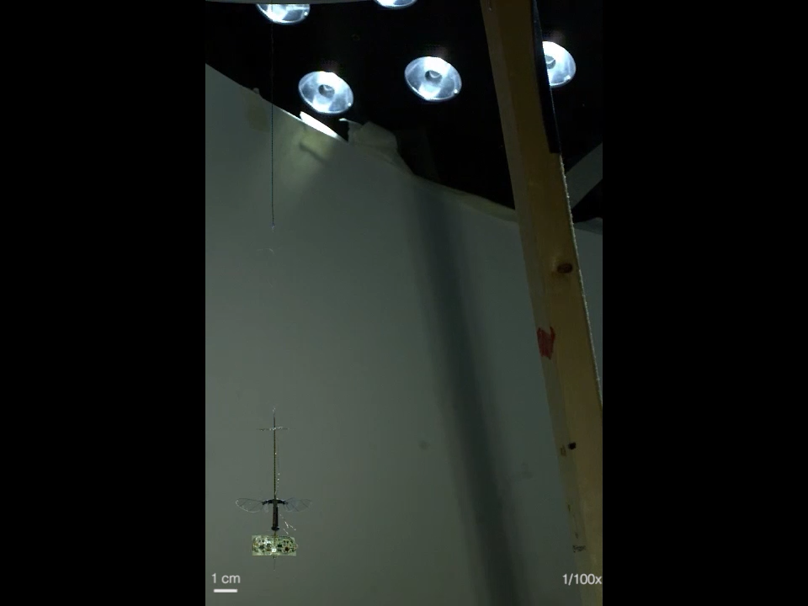
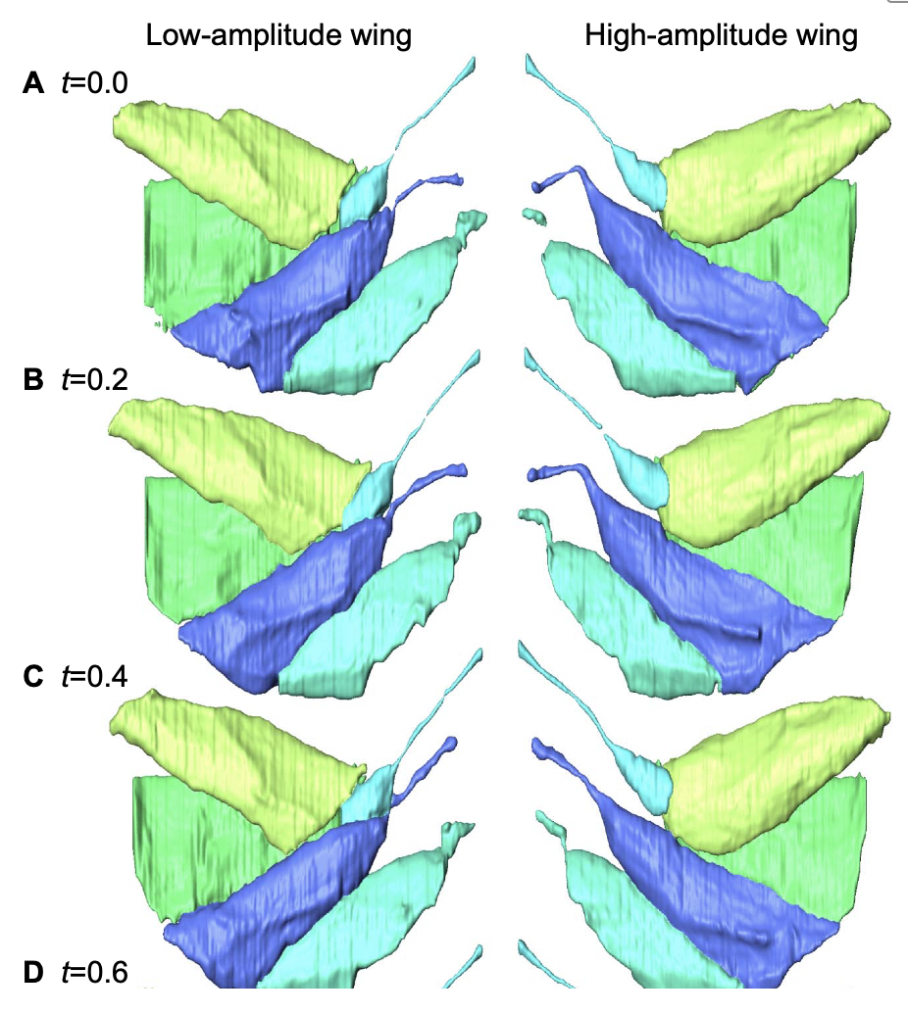

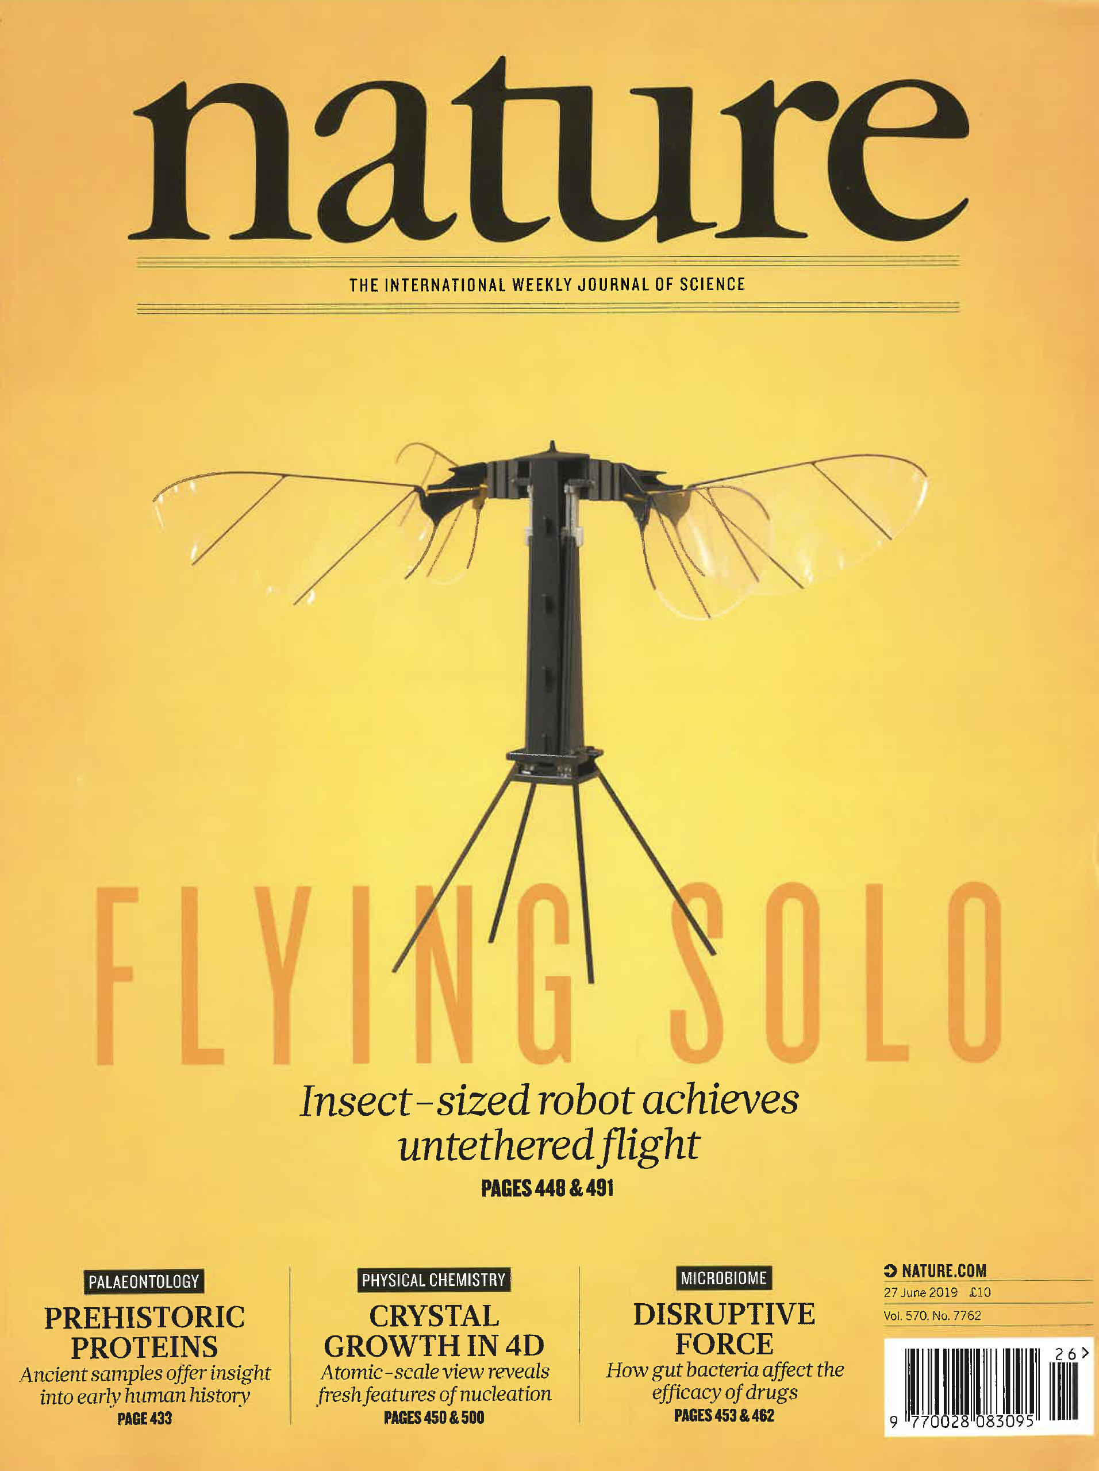
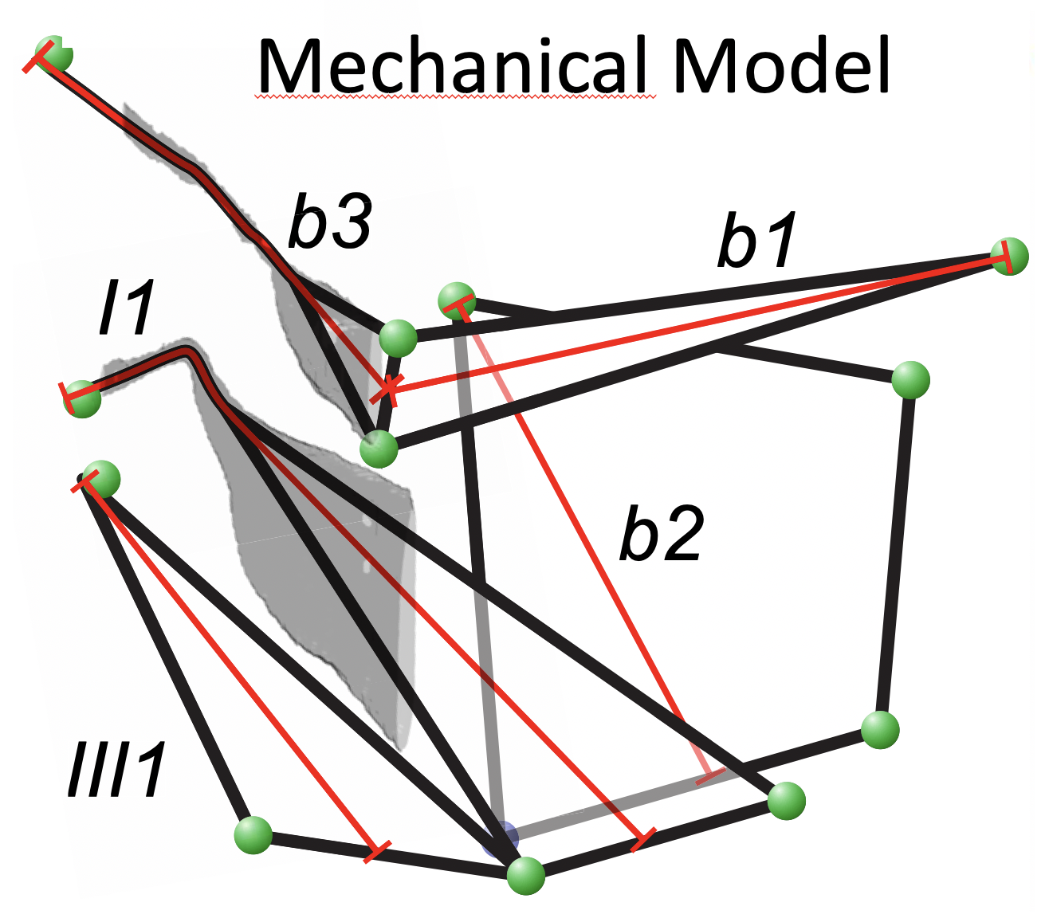
Dynamic X-ray microscopy boosting the development of bio-inspired robotics
Walker S. et al., PloS Biology (2014)
Jafferis et al., Nature 2019
03.12.19
PGZ slides extrait
Notes:
Untethered flight. The integrated vehicle successfully takes off and performs a sustained untethered flight. The light source provides a light intensity of approximately three Suns directly above the vehicle, outside the field of view. The Kevlar thread above the solar array is for vehicle safety (it provides neither current nor support during flight).

